Slide 1
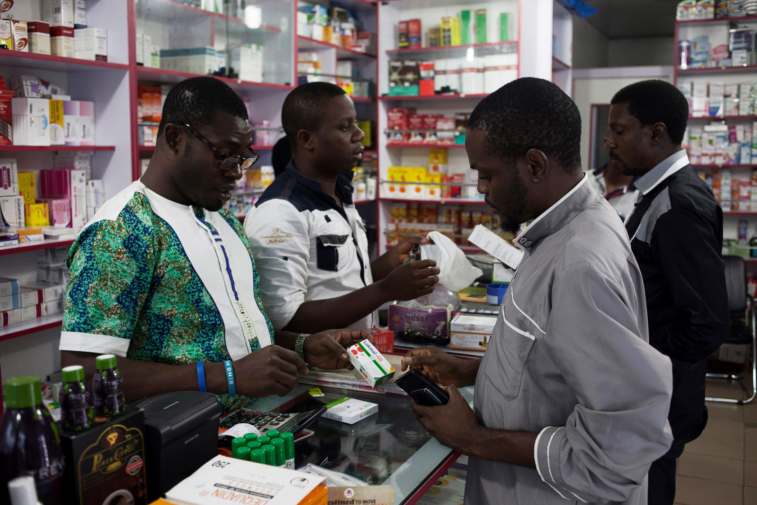
ACTwatch Lite pilots from 2023-2025 were conducted using SurveyCTO. Other ODK platforms may be used to conduct electronic data collection. Adapt this deck to the tool(s) used for this implementation

Slide 2

[COUNTRY, YEAR]
Module 6. Introduction to SurveyCTO

Slide 3
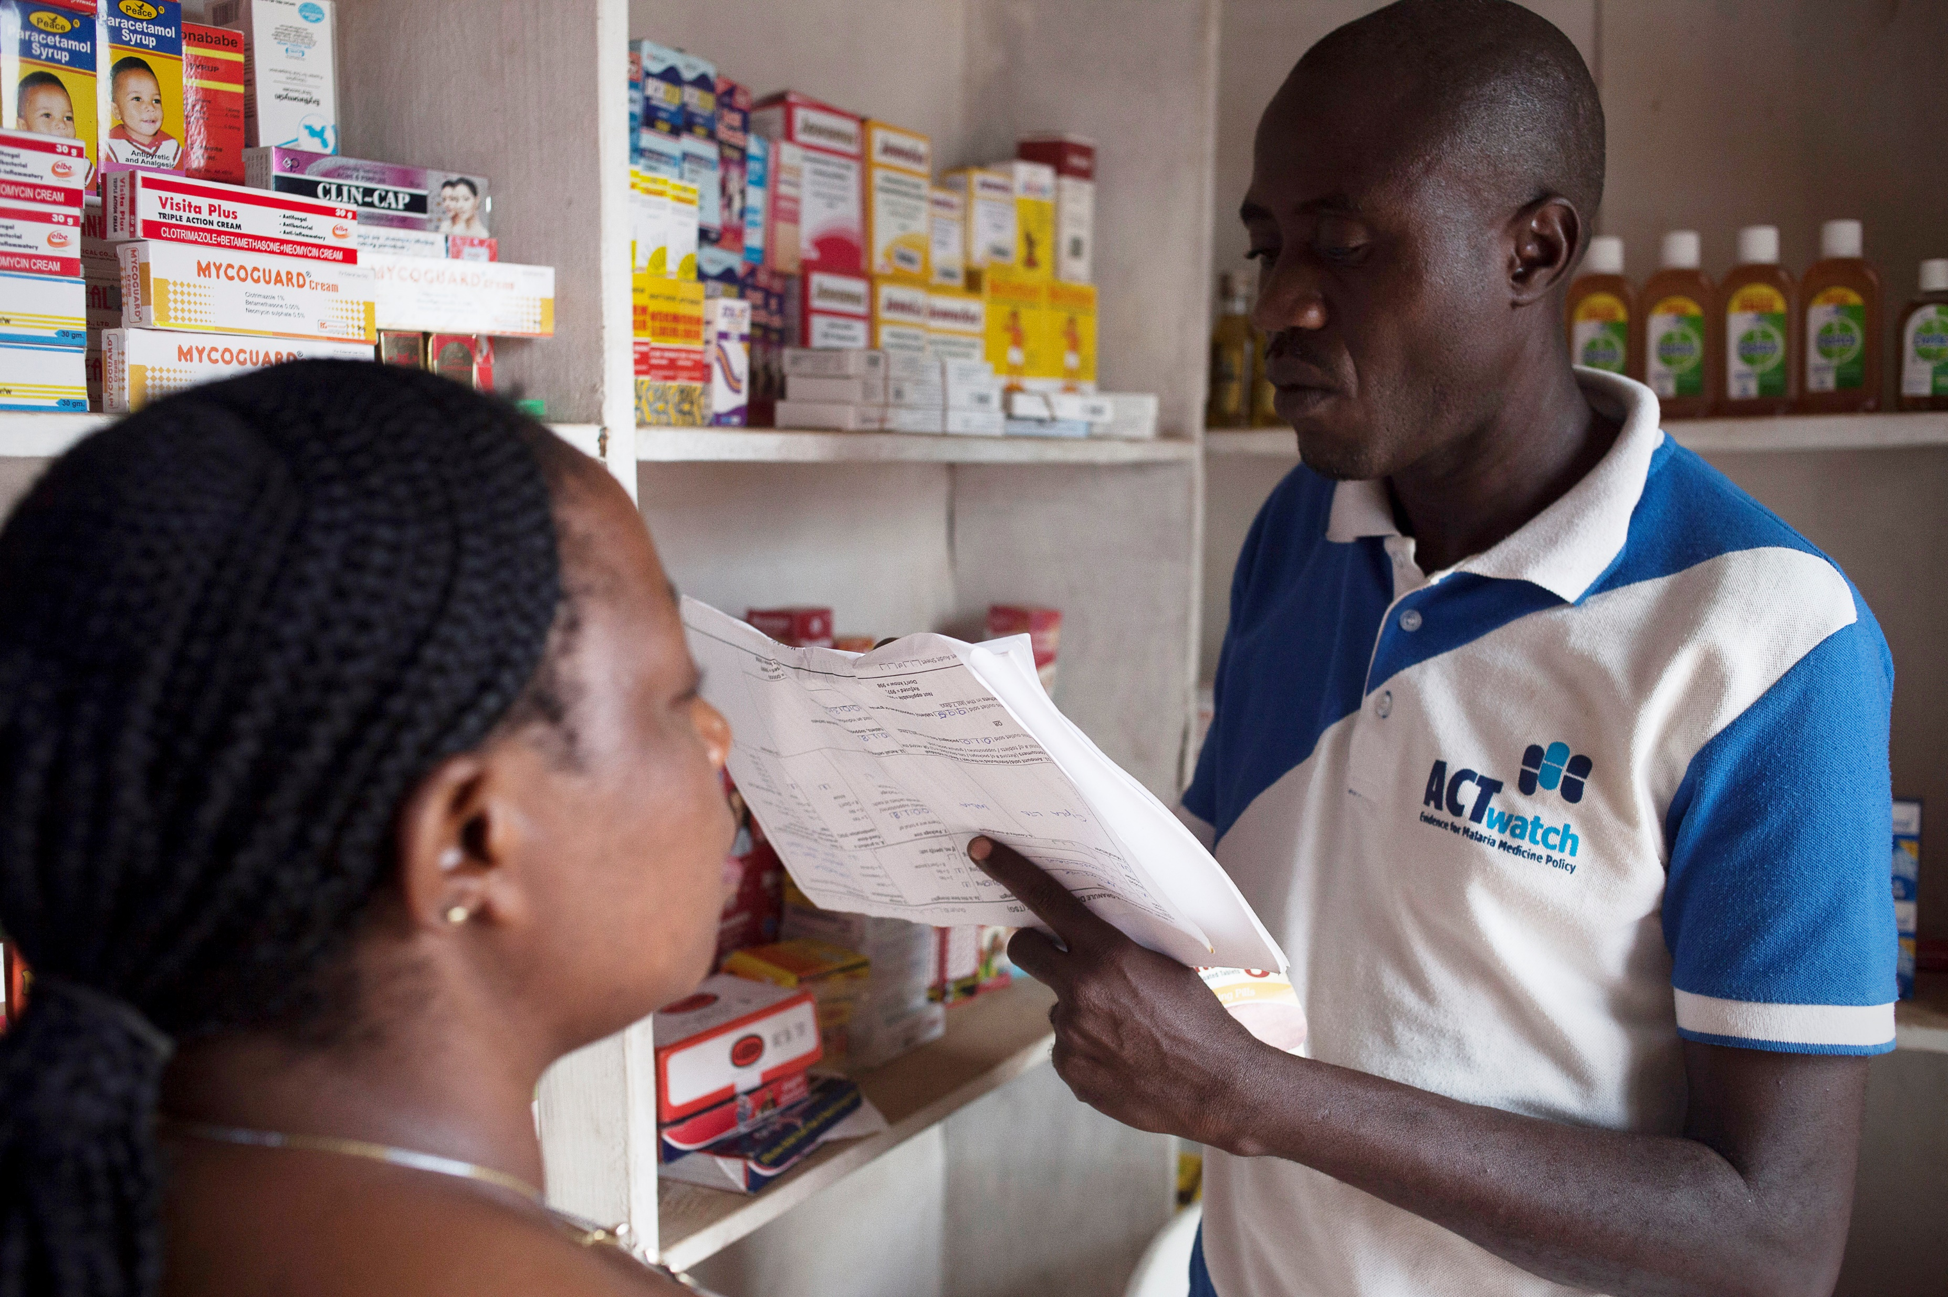
Agenda
6.1 Introduction to software and set up
Review of form
Review differences with:
Formal and informal
Retailers versus suppliers/wholesale outlets

Slide 4
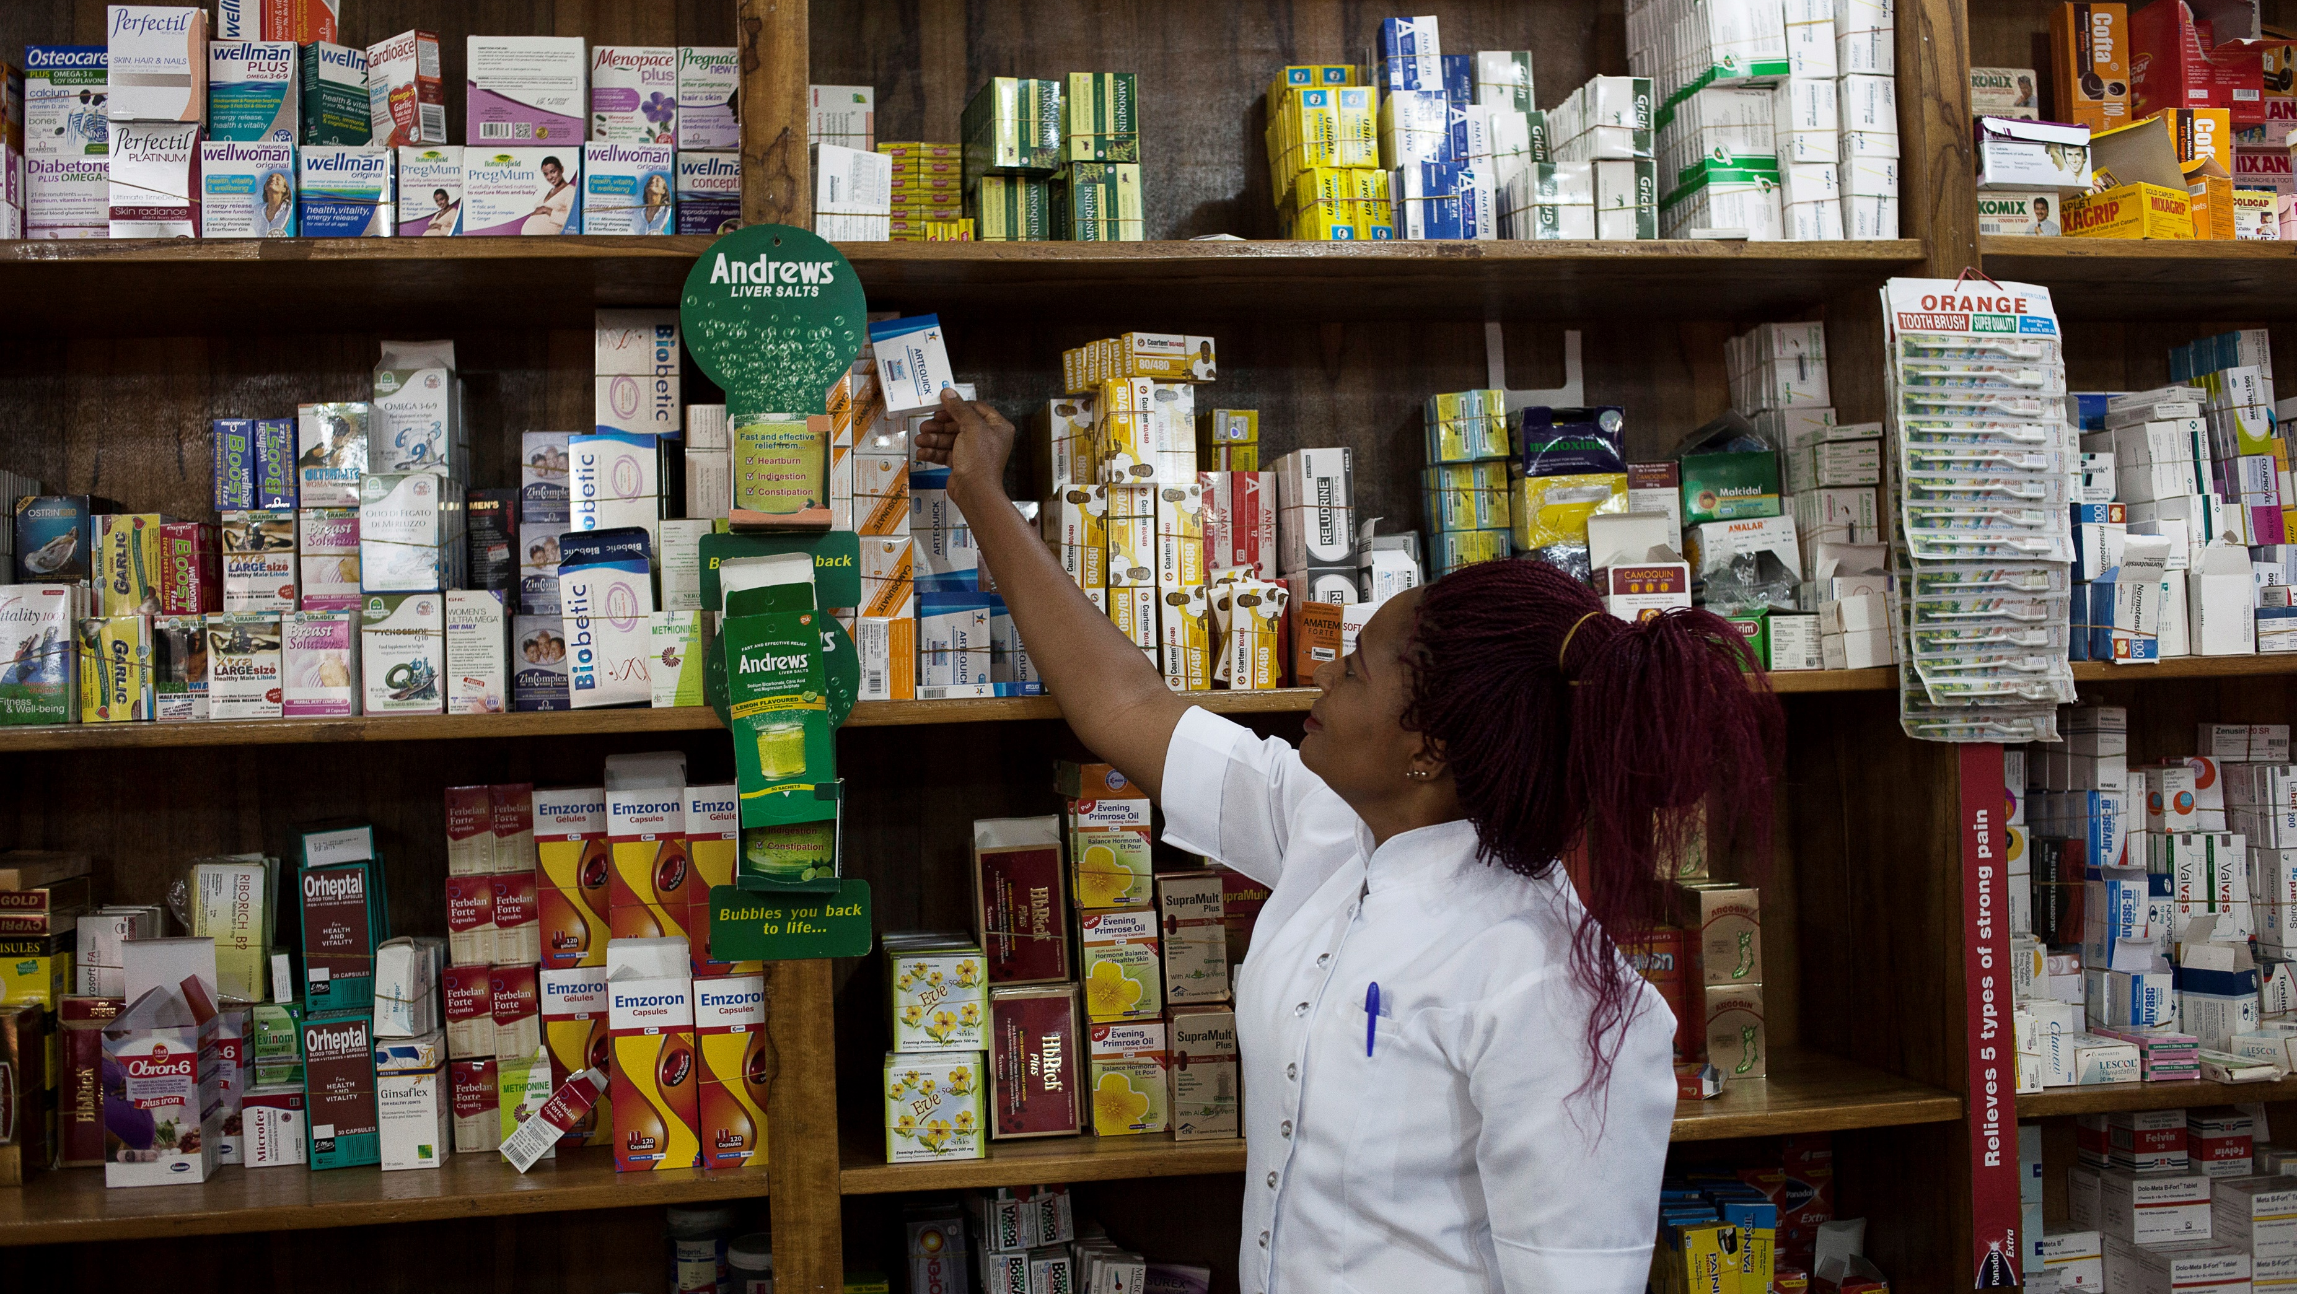
6.1 Introduction & set up of SurveyCTO Software

Slide 5
TRAINER NOTES
Objective:
Introduce data collectors to the SurveyCTO platform and ensure they know how to install the app, log in, and prepare devices for daily use.
Prompts & Answers:
What is SurveyCTO used for? ➔ A mobile data collection tool used to conduct interviews and product audits electronically.
How to install and set up SurveyCTO? ➔ Download the app from Play Store (if not pre-installed). ➔ Enter server name and username provided by the field team supervisor. ➔ Connect to internet to download forms and submit data.
When to enter the key credentials? ➔ On first login or when switching users. ➔ Do not edit server settings unless instructed by the supervisor.
What if login or form download fails? ➔ Check internet connection, check spelling of server/user name. ➔ If still failing, contact the field team supervisor or IT focal point.

Slide 6
OBJECTIVES
At the end of the course, participants will know how:
How to download and install the SurveyCTO Collect application.
How to connect and set up.
How to download questionnaire forms.
How to delete saved forms.
How to navigate the software and the form.

Slide 7
DATA ENTRY
Can be done electronically.
A small number of paper questionnaires may be available for emergency situations to be entered in to tablets at a later time.
ACTwatch Lite uses tablet to capture data using an Open Data Kit (ODK) system hosted on SurveyCTO.
Enables automated jumps and checks.
Includes internal GPS readout
Used to map and identify points of sale during tracking.
Data is uploaded daily by surveyors to the [Name of your organization] SurveyCTO server.
Add a screenshot of paper/ printable version of your questionnaire here if applicable
Notes:
Some general rules regarding the filling of the questionnaire are the following:
Never read out loud the options of the question to the respondents. Rather listen to what he is saying and and based on that response mark the corresponding option in the questionnaire
If the question involves things that happened in the past and the respondent cannot immediately recall, assist in talking him/her through the event to facilitate correct recall
In case the response given does not directly match the options in the wording in the questionnaire tick the option that is closest to the response, i.e. that is identical from the meaning or content even the respondent phrased it differently. If the response does not fit in any category, i.e. very different from any options stated, then mark the "other" option
Pay close attention to the skip patterns, i.e. the instruction in the questionnaire where to go next depending on the responses obtained (this does not apply in data collections with digital devices)
Always mark the questionnaire clearly so that the data entry staff can have no doubt what the response was

Slide 8
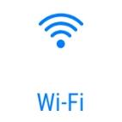
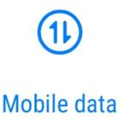
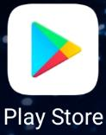
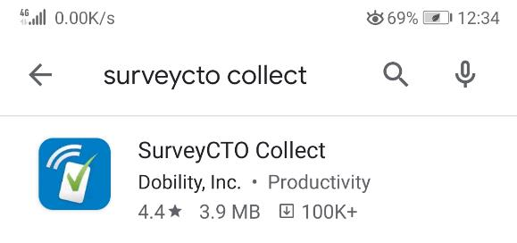
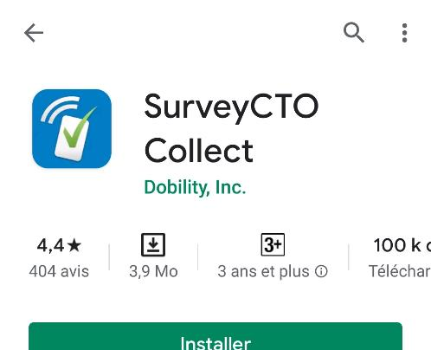
DOWNLOAD AND INSTALLSURVEYCTO COLLECT
Ideally, this stage should be completed before the training. However, for troubleshooting in the field, the team should be prepared to resolve issues on their own, with support from the HQ team if internet connectivity permits.
Make sure your device is connected to the Internet
Tablets run Android OS
Go to Play Store
Type SurveyCTO Collect in the search box and select the application

Slide 9
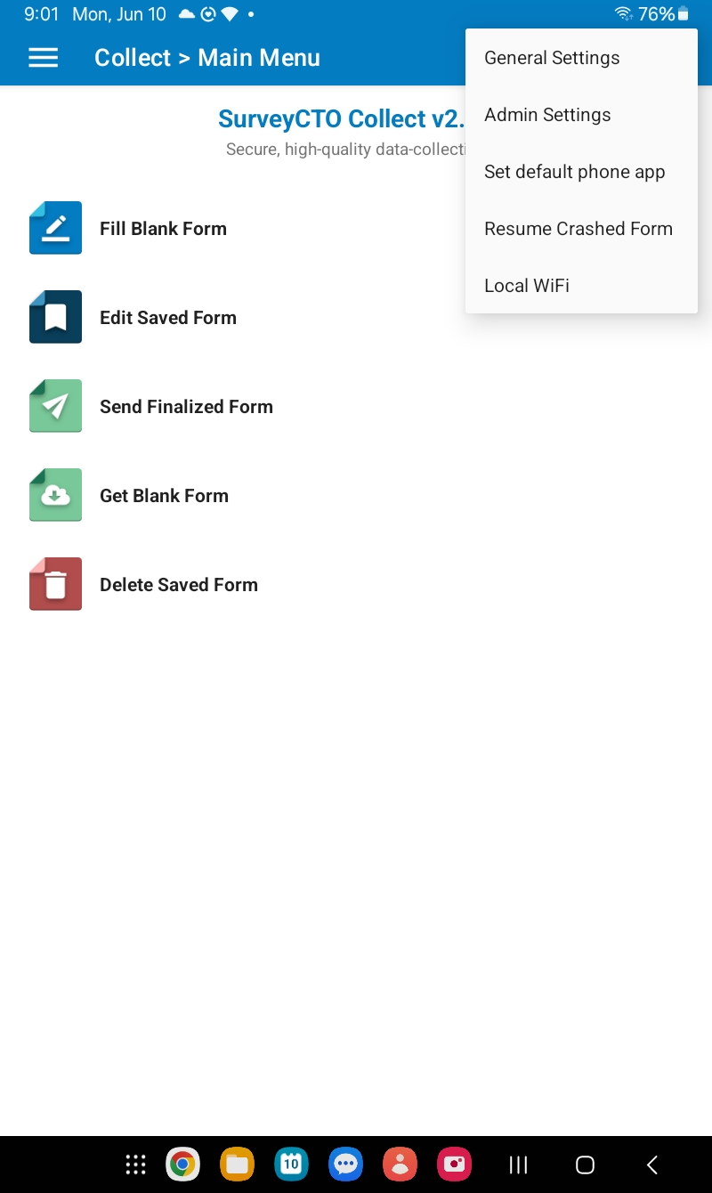
CONFIGURING SURVEYCTO COLLECT
Similarly, consider configuring devices before training.
Configure main parameters to access the server. →
The main parameters can also be accessed via the 3 dots in the top right-hand corner.
Select General Settings.

Slide 10
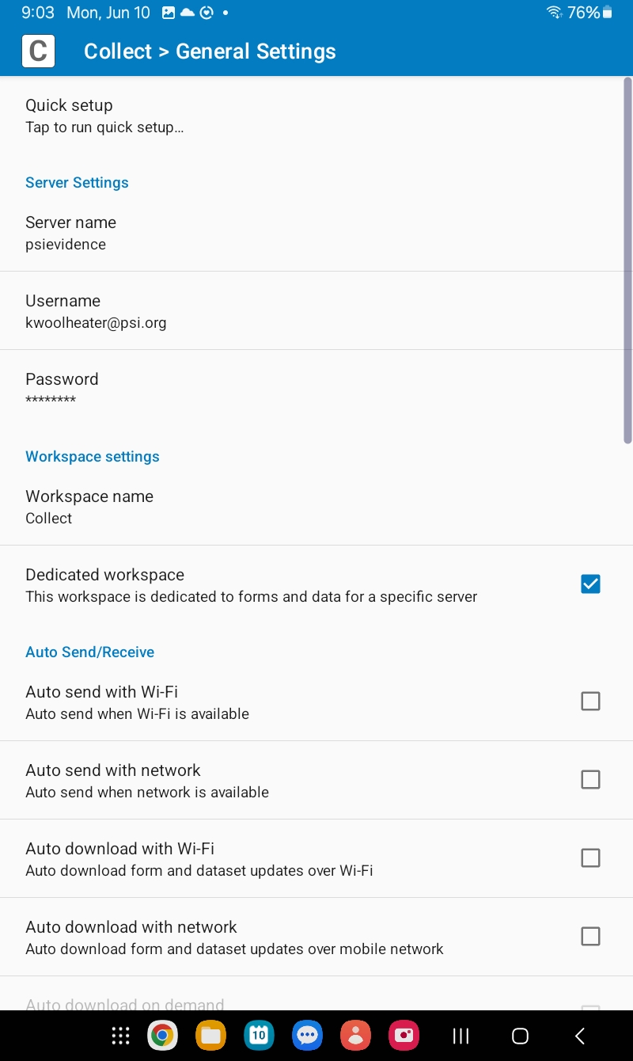
CONFIGURING SURVEYCTO COLLECT
Server name = xxx
Enter the username and password you have been given
Username | Password
xxx | xxx
Training facilitators:
Please adapt this slide for your study.

Slide 11
ADDITIONAL PREFERENCES
Best practices:
Configure the admin settings
Set a simple password to protect the Admin settings (same for all tablets)
Deselect « general settings »
Deselect « Delete Save form »

Slide 12
ADDITIONAL PREFERENCES
Best practices:
General settings
Select all options of auto Send/Receive: 5 options
Select “Display send/receive status”
User interface
Navigation: “use swipes and buttons”
Deselect: Default to finalized (mark form as finalized by default)
Days to auto-backup: make 1 day?

Slide 13
ADDITIONAL PREFERENCES
Configure an app to block the other apps in the phone (optional)
Eg: AppLock master app?
Don’t lock SurveyCTO, photo
Configure Vysor app for showing the tablet ? (optional)
Best practices:

Slide 14
CONFIGURATION OF SURVEYCTO COLLECT
Participant name | Identifier | Password
xxx | Username | Password
Note to facilitators:
Adapt to your study

Slide 15
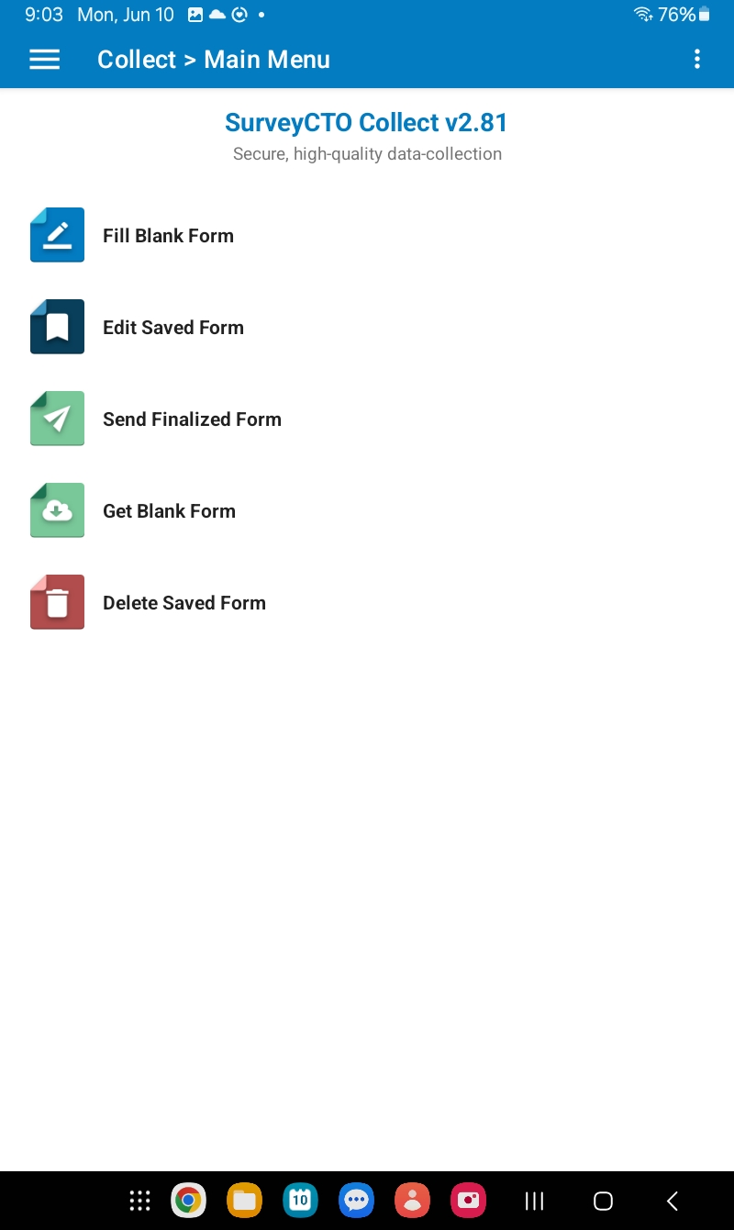
DOWNLOAD BLANK FORMS
Note to facilitators: replace with your own study’s screenshots.
Select “Get blank form".

Slide 16
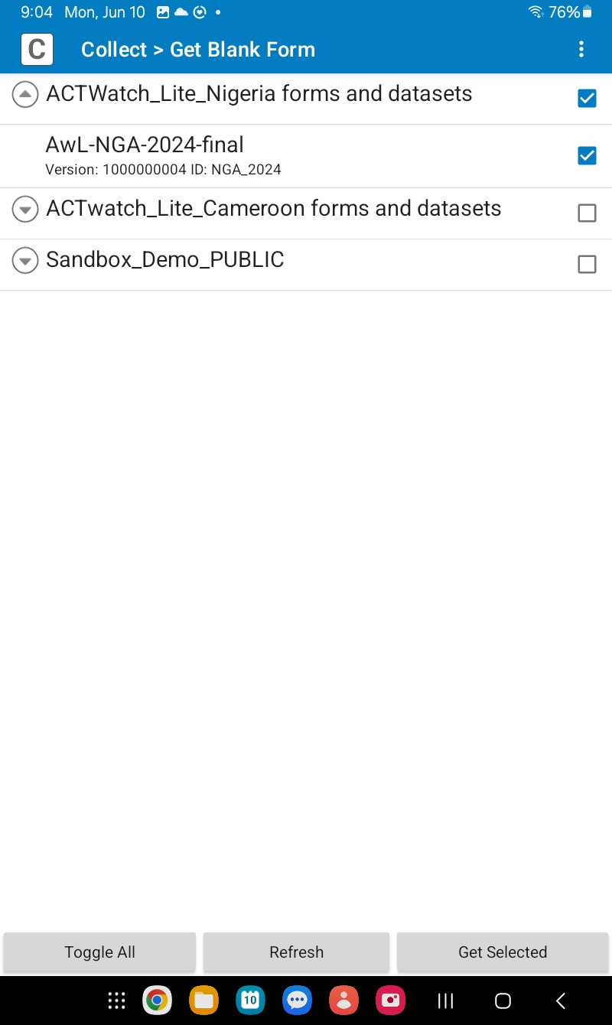
DOWNLOAD BLANK FORMS
Note to facilitators: replace with your own study’s screenshots.
Select the form and check the version number
Select form and download

Slide 17
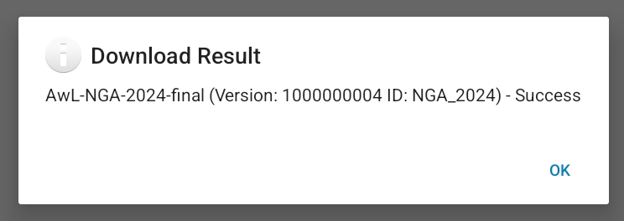
DOWNLOAD BLANK FORMS
Wait for the multimedia files to download as well.
Click OK when the download is complete.

Slide 18
NEW SURVEY VERSIONS
When a new version is available and you are prompted to download it, follow the same process.
All versions are stored, but the old version is replaced by the new one when the blank form is filled in.

Slide 19
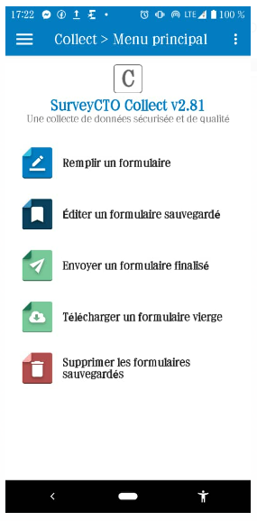
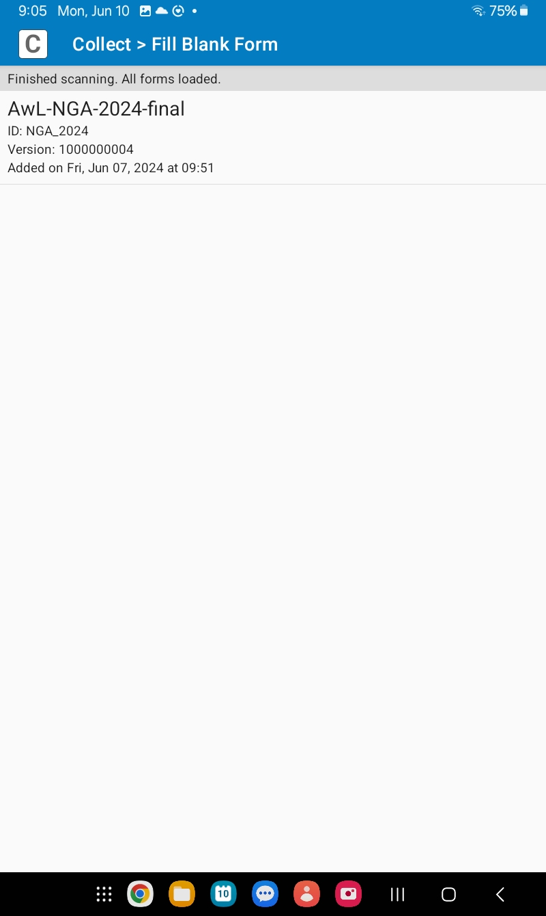
ACCESS THE FORM
Note to facilitators: replace with your own study’s screenshots.
Open SurveyCTO Collect and go to "Fill in a form."
Open the ACTwatch Lite (AwL) form for your country.

Slide 20
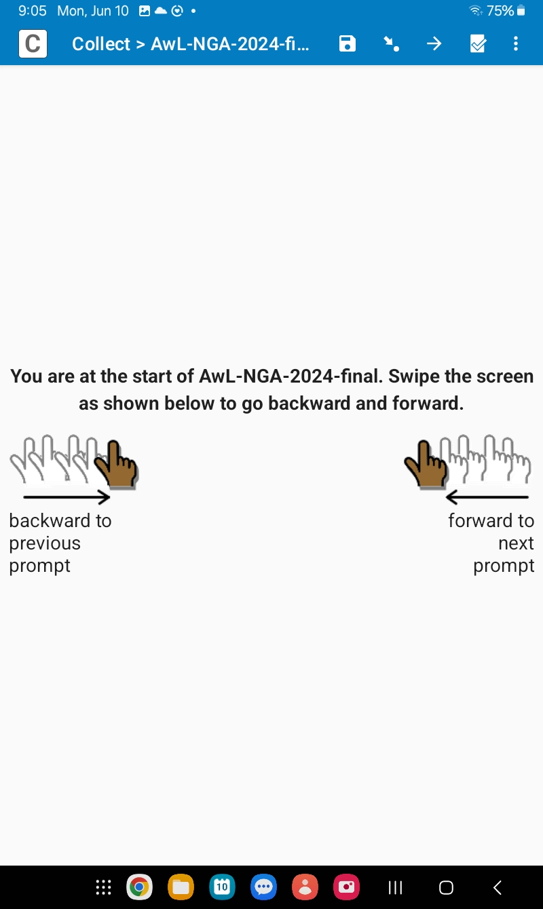
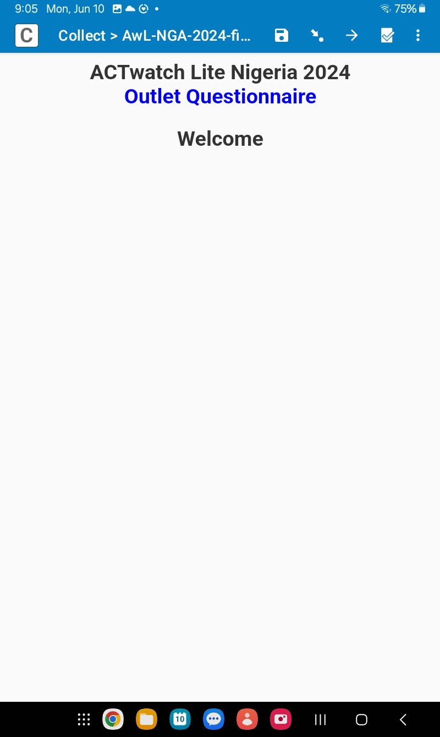
MOVING AROUND THE SURVEY
Note for facilitators: Update this slide with the questionnaire to be used in your study.

Slide 21
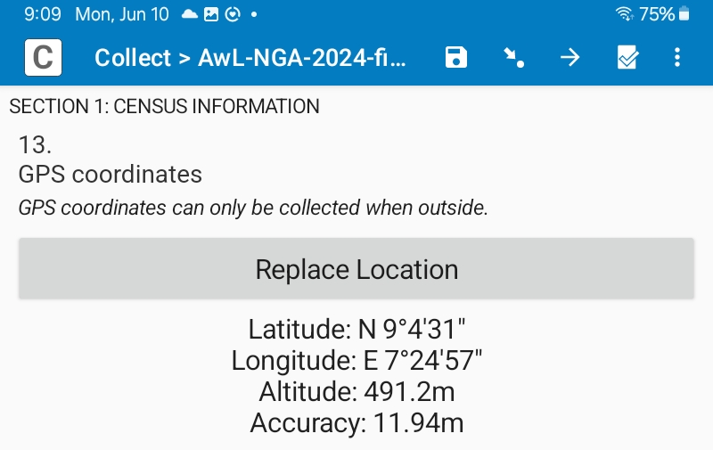
GPS
Note for facilitators: Update this slide with the questionnaire to be used in your study.
Where possible, wait until you have a precision of <10m.
Remember you will not be asked for GPS if you are at an « informal » outlet.

Slide 22
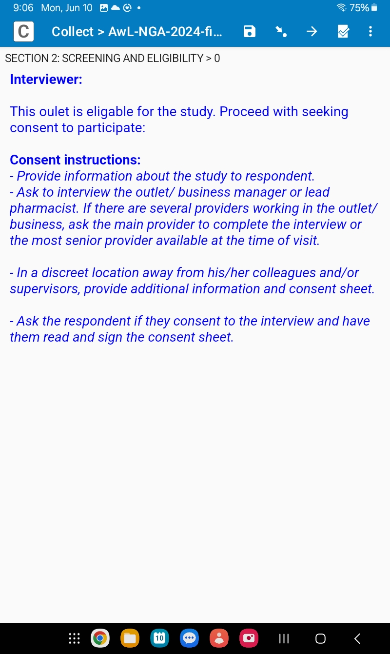
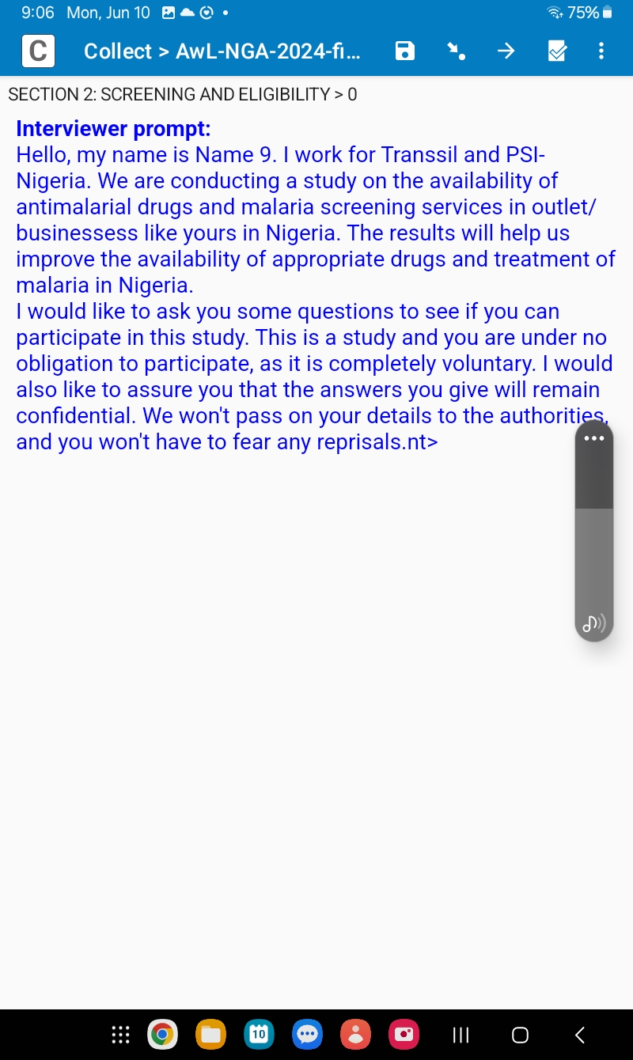
OBTAIN CONSENT
Note for facilitators: Update this slide with the questionnaire to be used in your study.
Complete Section 0: Form Selection and Section 1: Census information ***before entering an outlet.***
Then, proceed to the outlet and begin Section 2: Eligibility and Consent.

Slide 23
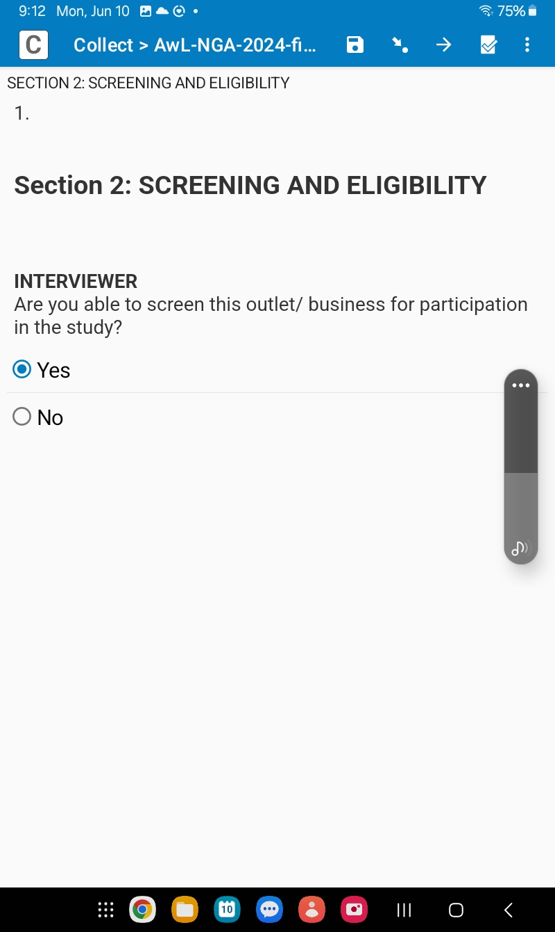
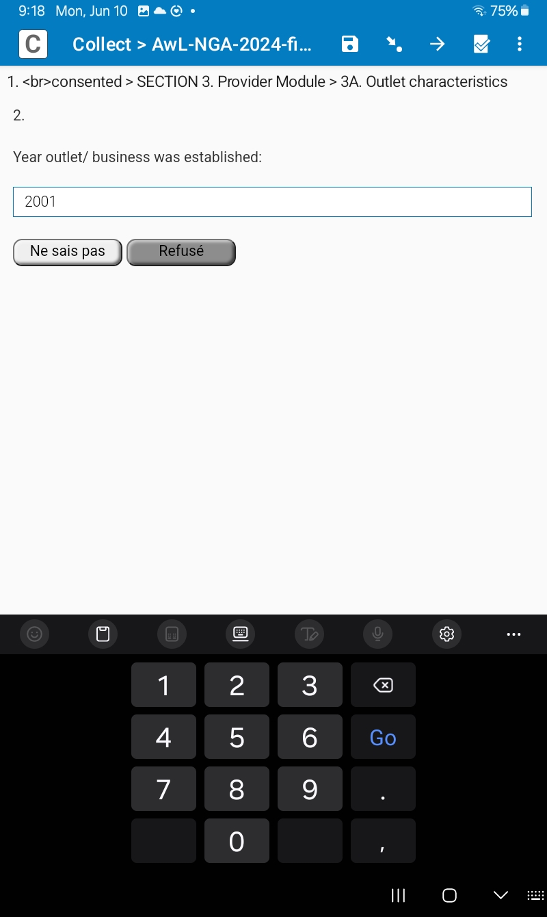
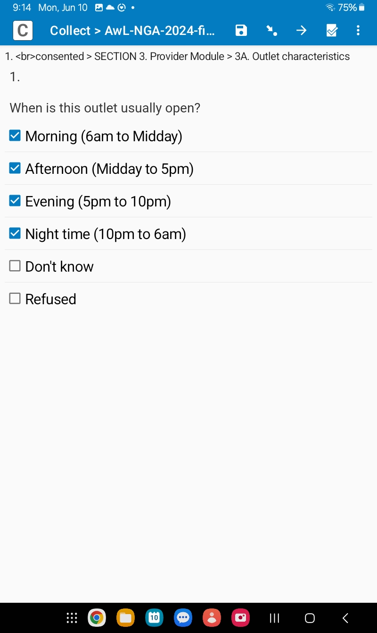
DIFFERENT TYPES OF QUESTIONS
Note for facilitators: Update this slide with the questionnaire to be used in your study.
Free text
Select one
Select multiple
Etc.

Slide 24
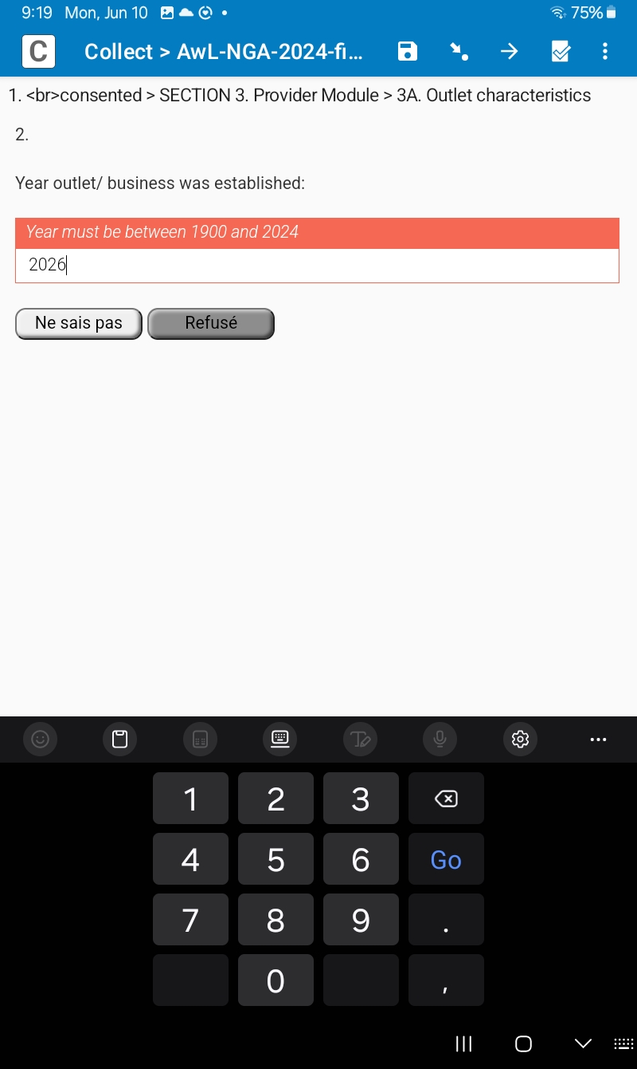
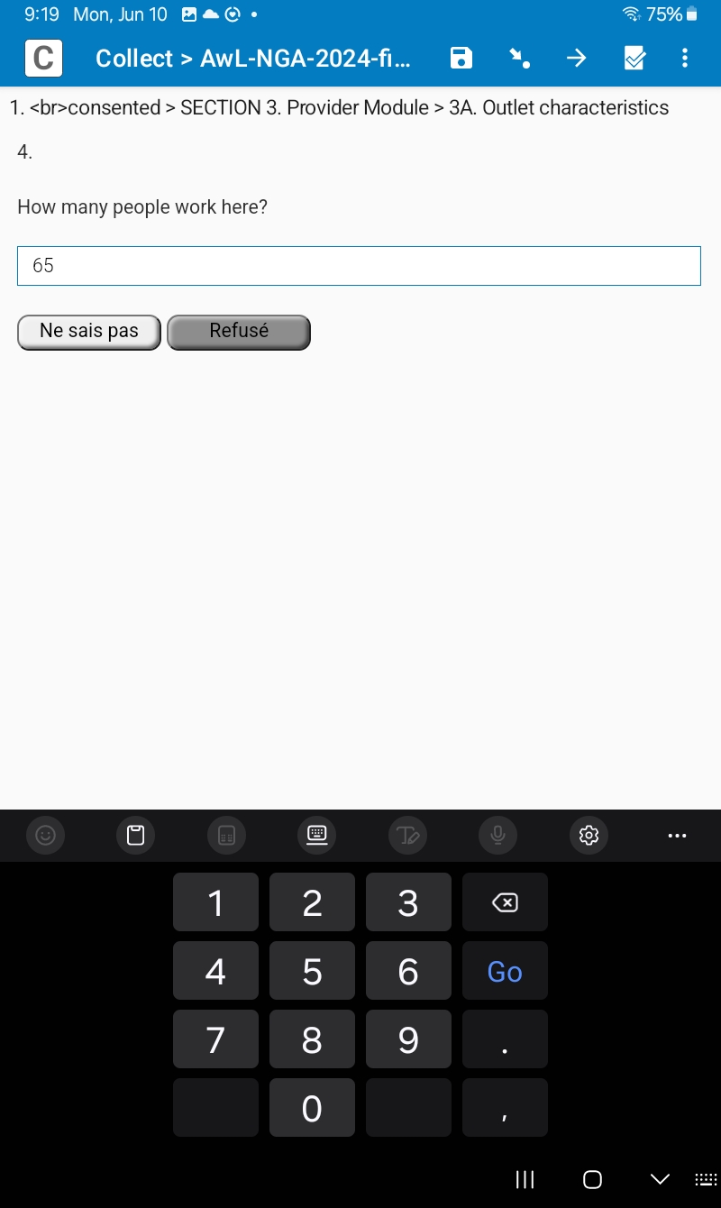
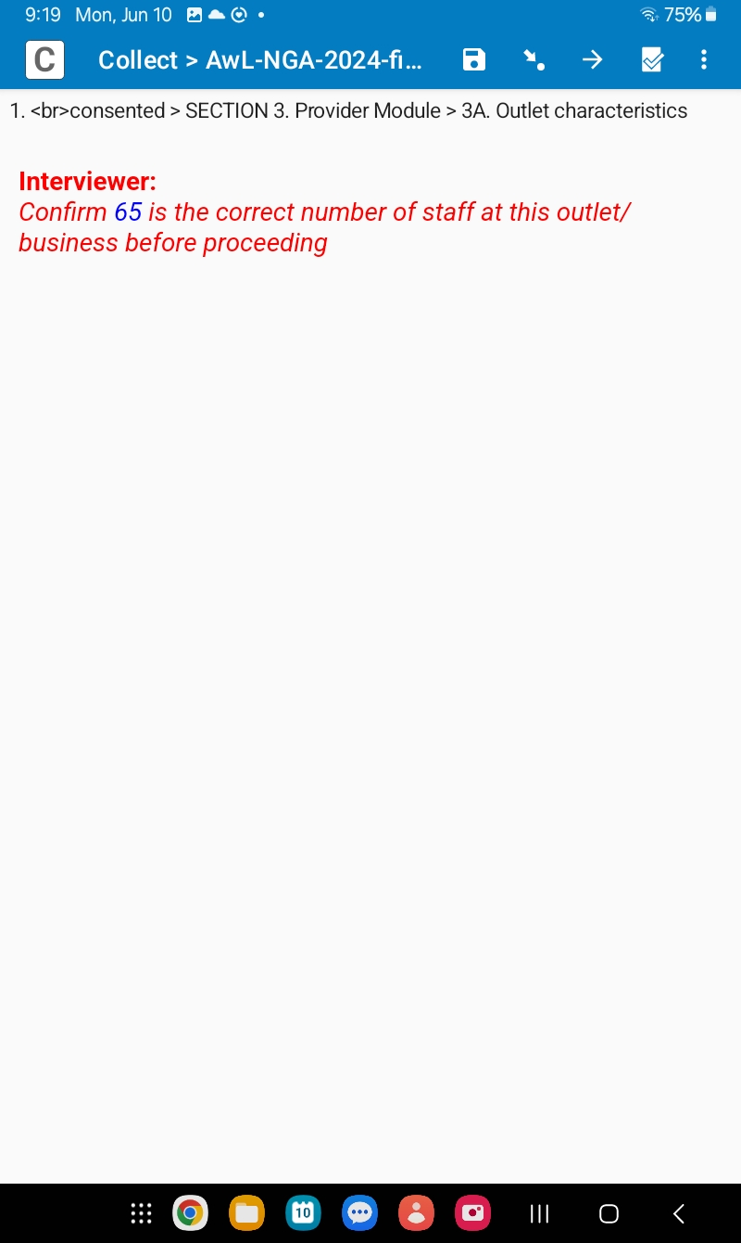
WARNING TYPES
Note for facilitators: Update this slide with the questionnaire to be used in your study.

Slide 25
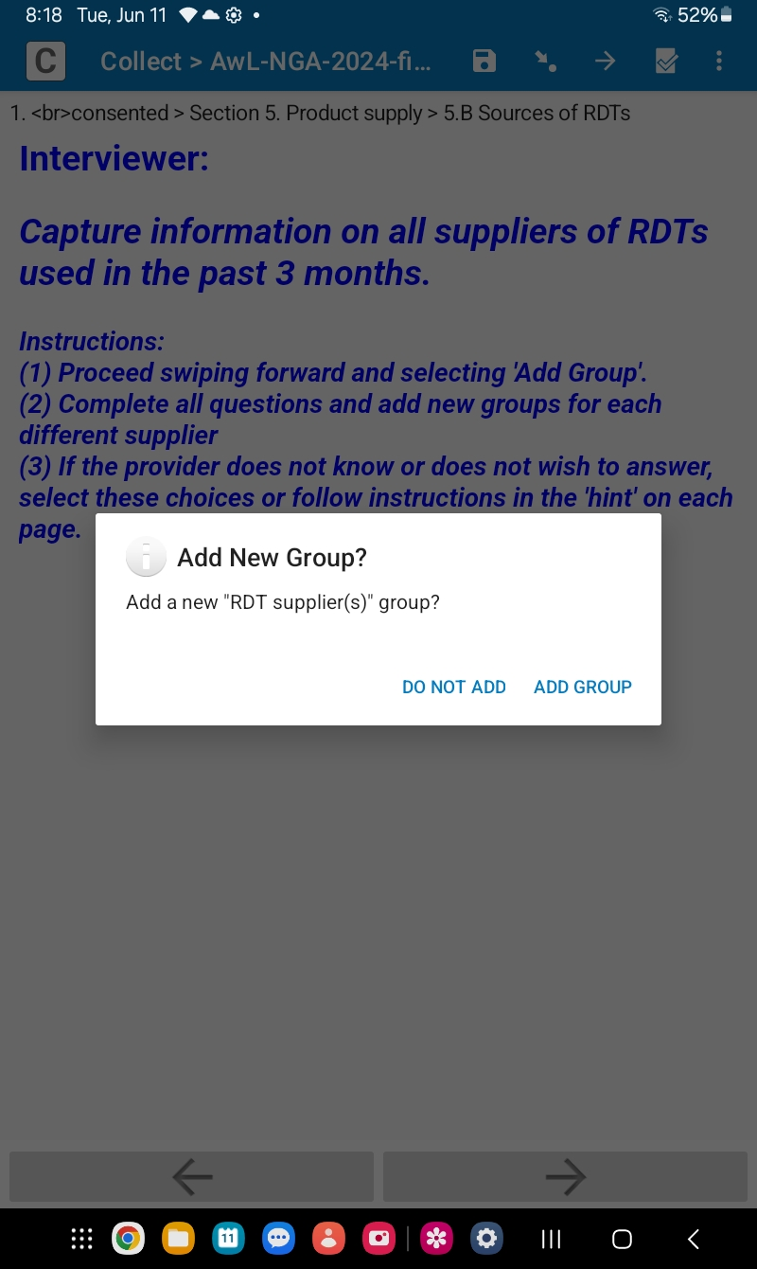
ADD A NEW GROUP
Note for facilitators: Update this slide with the questionnaire to be used in your study.
In several sections of the questionnaire, SurveyCTO will ask you to confirm that you wish to add another record, called a "group" in the application:
Audit of antimalarial drugs
Audit of RDTs
List of anti-malarial suppliers
List of RDT suppliers
Select "Add a group" to add data. For example, another antimalarial or another RDT in the audit.
Select "Do not add" when there are no more products or suppliers to capture.

Slide 26
DELETING A GROUP ADDED BY ACCIDENT
If the team member mistakenly clicks on the "Add group" button when there is no new group to add.
Once the button is clicked, SurveyCTO automatically creates an entry that cannot be cancelled by going back.
→ What to do?

Slide 27
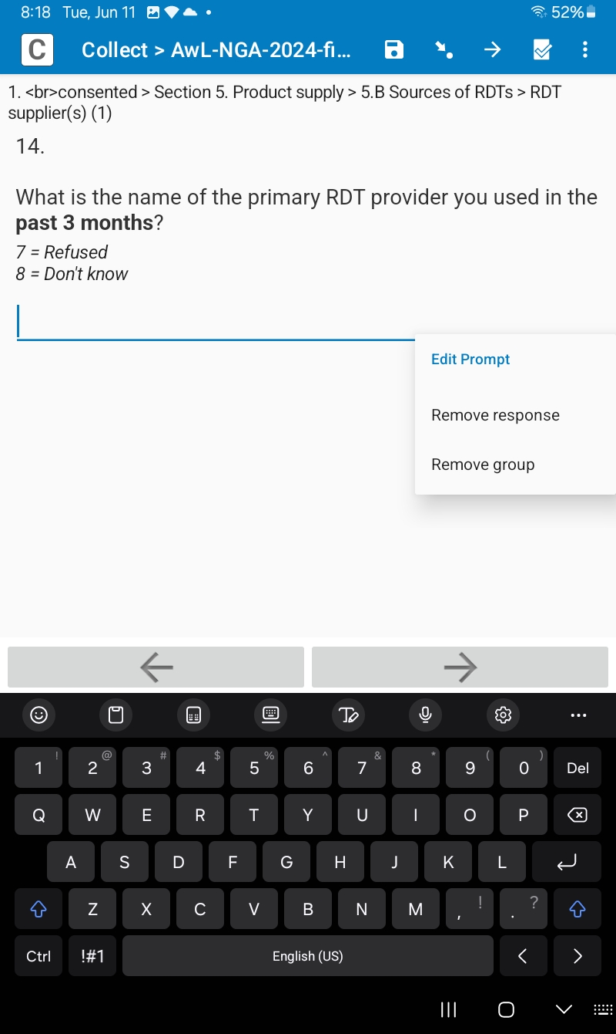
DELETING A GROUP ADDED BY ACCIDENT
On the next page, press and hold the screen (next to an answer option) until the following message appears
Select "Delete group" and you'll get a confirmation message.
Select "OK" again.
The entry is deleted (the entry number is shown in brackets).
You will then automatically return to the previous page.

Slide 28
Thank you for your attention!
Any questions?

Slide 29
6.2 REVIEW FORM

Slide 30
TRAINER NOTES
Objective:
Ensure data collectors are familiar with the structure of the ACTwatch Lite form in SurveyCTO and know how to review it carefully before starting data collection.
Prompts & Answers:
Why do need to review the form before going to the field? ➔ To understand question flow, skip patterns, and where to find key fields. ➔ Helps reduce mistakes during actual interviews.
What should look for during the review? ➔ Confirm presence of all expected sections (e.g., Census, Provider, AM audit, RDT audit). ➔ Check that repeat groups (e.g., product entries) open and close correctly.
Should real data be used during form review
➔ No - use training cases or examples from slides. ➔ Never enter real outlet data during form review.

Slide 31
SURVEYCTO QUESTIONNAIRE FLOW
Census information
Outlet characteristics
Eligibility questions
Operational practices
Provider characteristics
Malaria knowledge
Digital preparedness/ practices
AM suppliers
Product supplier information
RDT suppliers
Product audits
Antimalarials
Interview status
RDTs

Slide 32
REFRESHER
Access the study form on your tablet.
Raise your hand when you have it open.
It’s a race!!

Slide 33
EXERCISE 1
Let’s go through the whole form together.
Nominate one person to record suggested changes to the form, bugs, etc.

Slide 34
EXERCISE 2
Divide into groups and practice with the tablets, going through the scenarios in the next slide

Slide 35
RETAIL Scenarios
Role-playing in pairs (Retail questionnaire in SurveyCTO)
Eligible outlet (Drug & RDT) and interview completed
Eligible outlet (drug only) and interview completed
Eligible outlet (RDT only) and interview completed
Ineligible outlet: does not meet selection criteria
Interview interrupted
Eligible provider not available / time not convenient
Outlet not open at time of visit
Outlet permanently closed
Refusal to participate

Slide 36
WHOLESALE Scenarios
Role-playing in pairs (wholesale questionnaire in SurveyCTO)
Eligible wholesaler (drug & RDT) and interview completed.
Eligible wholesaler (drug only) and interview completed, audit refused.
Refusal to participate.

